Slide 1
Classification
CLASSIFICATION
PERFORMANCE ANALYSIS
Tomasz Janeczko, Lukáš Hofman
1

Slide 2
Problem
One of the most important tasks in machine learning is classification, and a model trained to recognize label data points using features. The five different classification methods are analyzed in this project.
In this study, our goal is to find the best-suited method by comparing Precision, Recall, Specificity, False Negative Rate, False Positive Rate, Accuracy, Spatial Accuracy and F-measure providing insight into each model’s strengths and weaknesses.

Slide 3
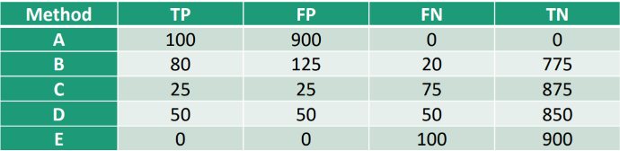
Our dataset
We use the provided dataset from pdf
5 columns: Method TP FP FN TN
- TP – True Positives
- FP – False Positives
- FN – False Negatives
- TN – True Negatives
5 Methods: A, B, C, D and E
Number of Samples: 1000
Imbalanced data – only 10% are positives
3

Slide 4
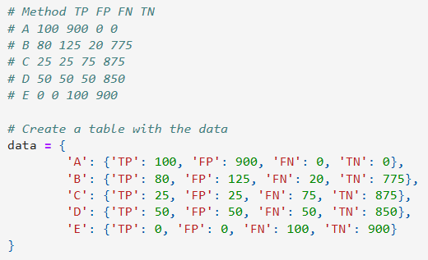
Creation of data

Slide 5
Possible methods
There are several techniques for clustering gene expression data, each with its own advantages and disadvantages.
K-means Clustering:
A well-known algorithm that divides data into a set number of clusters.
Other methods (not from our documents):
-Hierarchical
-Self-Organizing Maps
Divisive Analysis Clustering:
A divisive clustering method where all the observations are initially grouped together

Slide 6
K-mean algorithm
The k-means algorithm has two main steps:
1. Initialization: The algorithm places each item into one of k groups.
2. Iteration: The algorithm measures the distance between each item and each group, then moves the item to the closest group.
That is a partitional or nonhierarchical clustering method

Slide 7
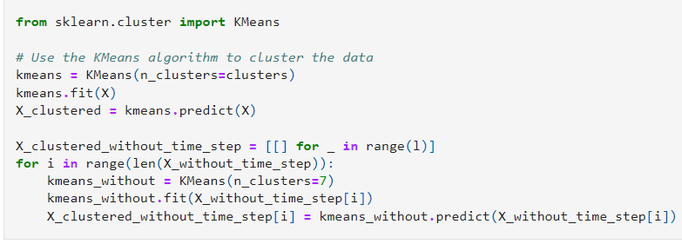
K-means Clustering – implementation of the algorithm

Slide 8
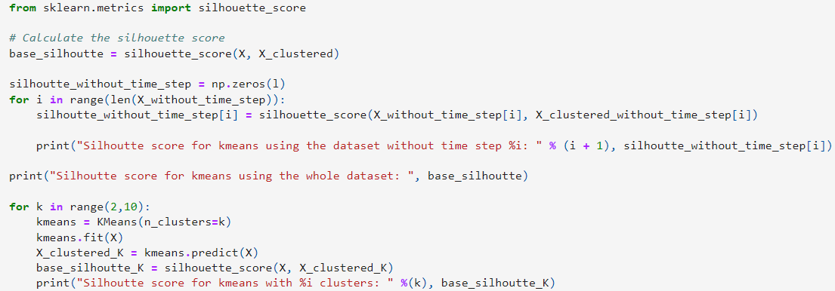
K-means Clustering - counting the silhoutte index

Slide 9
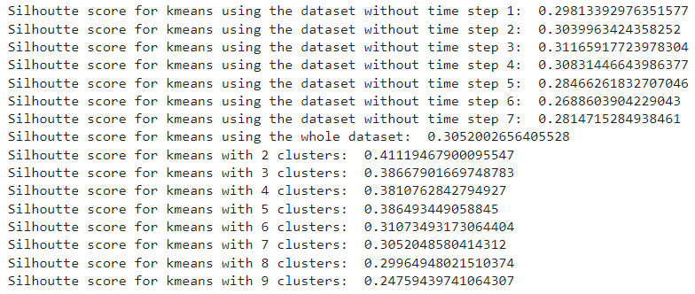
K-means Clustering – evaluating clustering performance
The Silhouette Index is a key metric for assessing the quality of clustering results in your dataset:
Values close to 0 indicate that the data point is located on or near the decision boundary between two or more clusters, suggesting that it is difficult to assign the point to a specific cluster
Values close to 1 indicate that the data point is well-clustered and clearly separated from other clusters
Values close to -1 indicate that the data point is likely misclassified or that the clustering is not well-defined

Slide 10
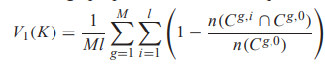
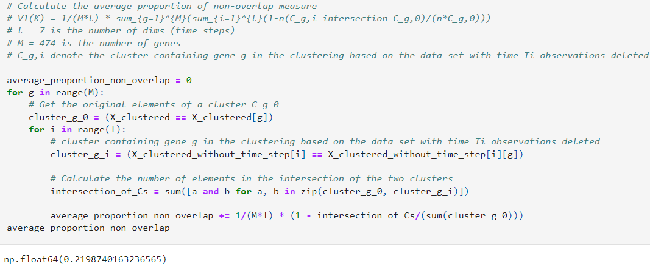
Comparison with existing results 1
The average proportion of non-overlap measure

Slide 11
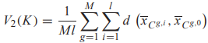
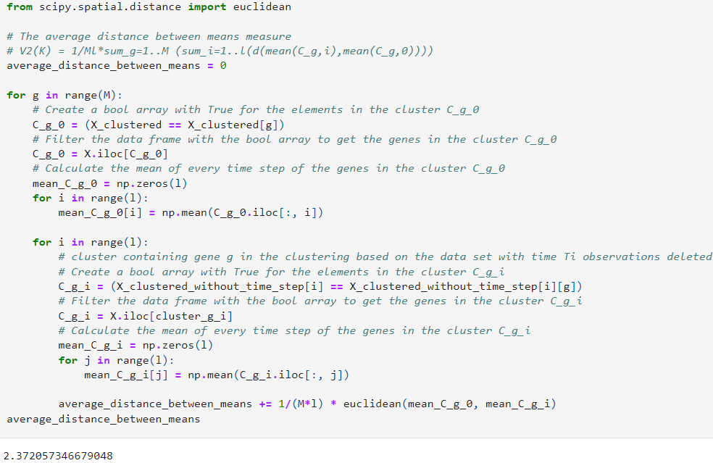
Comparison with existing results 2
The average distance between means measure

Slide 12
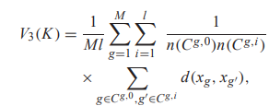
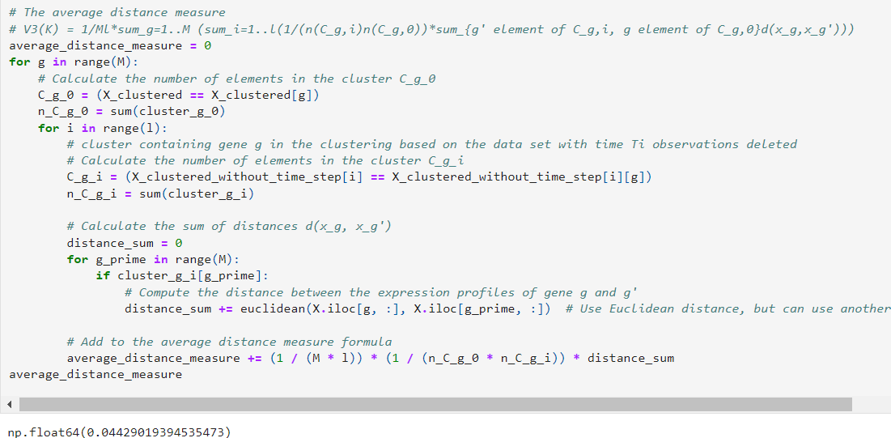
Comparison with existing results 3
The average distance measure, where d(xg, xg) is a distance (e.g. Euclidean, Manhattan, etc.) between the expression profiles of genes g and g

Slide 13
Comparison with existing results 3
The average distance measure, where d(xg, xg) is a distance (e.g. Euclidean, Manhattan, etc.) between the expression profiles of genes g and g

Slide 14
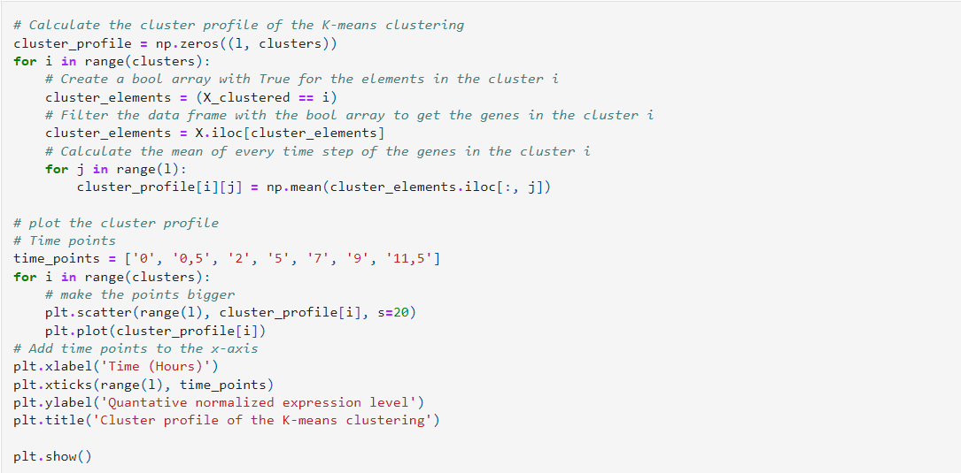
Average temporal profiles

Slide 15
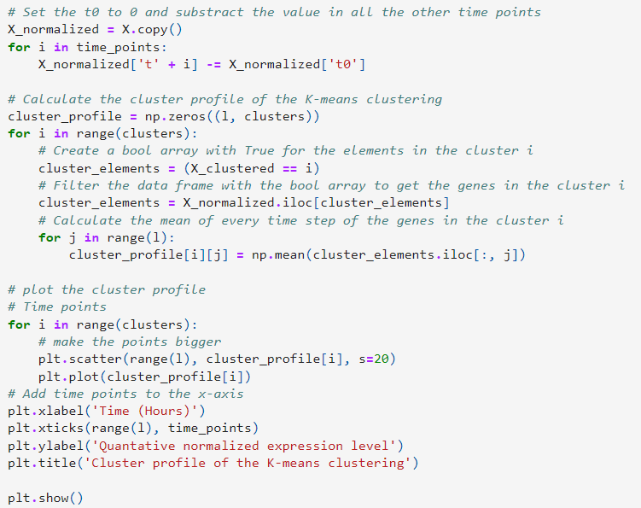
Normalizing the data to start at 0 at time step 0

Slide 16
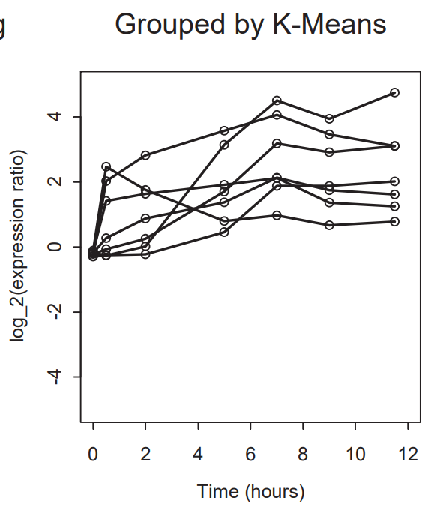
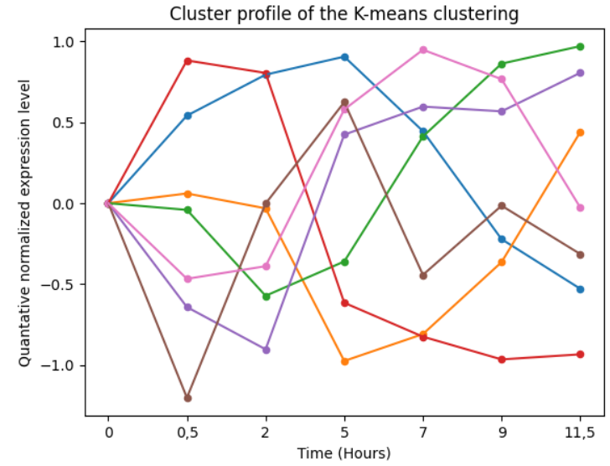
Comparison of the results

Slide 17
Conclusions
Similarity in clusters:
Genes in the same cluster often show similar patterns of expression over time, which suggests they might be regulated together or play roles in related biological processes.
Differences among clusters:
The different patterns seen in various clusters show that gene expression is diverse within the dataset. This indicates that the clustering method has successfully grouped genes with different functions.

Slide 18
Used sources
Slides from Lecture
https://informatica.cv.uma.es/pluginfile.php/654399/mod_resource/content/0/pract%202%20classification.pdf
https://en.wikipedia.org/
https://www.analyticsvidhya.com/articles/precision-and-recall-in-machine-learning/

Slide 19
Thank you for your attention
Co-authors:
Tomasz Janeczko, Lukáš Hofman
https://github.com/LuhiHofi/Aprendizaje-Computacional
Lab 2A Task
Aprendizaje Computacional (2024-25)
Universidad de Málaga

